Slide 2
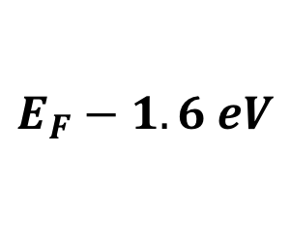
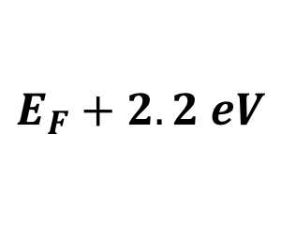
(a)
(b)
Au NC
(c)
Au NC
Au NC
5 nm
50 nm
125 nm
E
E
E
(d)
(e)
(f)
Cross Section (arb. units)
Hot-electron Population
Hot-hole Population
$$E_{F}+2.2 eV$$
$$E_{F}−1.6 eV$$
Energy (eV)
Time (fs)
Time (fs)

Slide 3
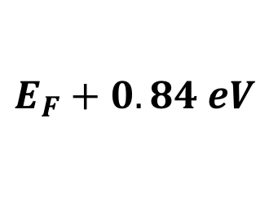
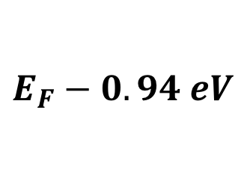
(a)
(b)
Pt NC
(c)
Pt NC
Pt NC
5 nm
50 nm
125 nm
E
E
E
(d)
(e)
(f)
Cross Section (arb. units)
Hot-hole Population
Hot-electron Population
$$E_{F}+0.84 eV$$
$$E_{F}−0.94 eV$$
Energy (eV)
Time (fs)
Time (fs)
1.97 eV transition -> 690 nm sphere has resonance well aligned.

Slide 4
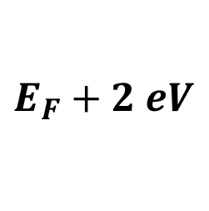
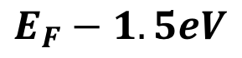
(a)
(b)
Ag NC
(c)
Ag NC
Ag NC
5 nm
50 nm
125 nm
E
E
E
(d)
(e)
(f)
$$E_{F}−1.5eV$$
Cross Section (arb. units)
Hot-hole Population
Hot-electron Population
$$E_{F}+2 eV$$
Energy (eV)
Time (fs)
Time (fs)
1.97 eV transition -> 690 nm sphere has resonance well aligned.

Slide 5
Pt
Pt
Pt
F-P
F-P
F-P
WGM
WGM
WGM
Pt
Pt
Pt
F-P
F-P
F-P
WGM
WGM
WGM

Slide 6
Au
Au
Au
F-P
F-P
F-P
WGM
WGM
WGM
Au
Au
Au
F-P
F-P
F-P
WGM
WGM
WGM

Slide 7
5 fs
10 fs
15 fs
20 fs
25 fs

Slide 8
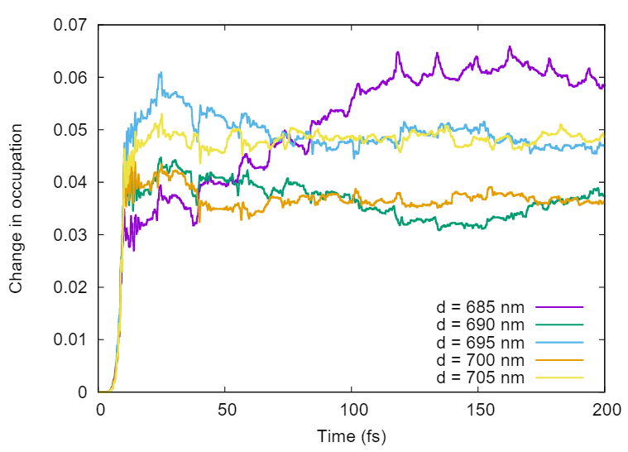
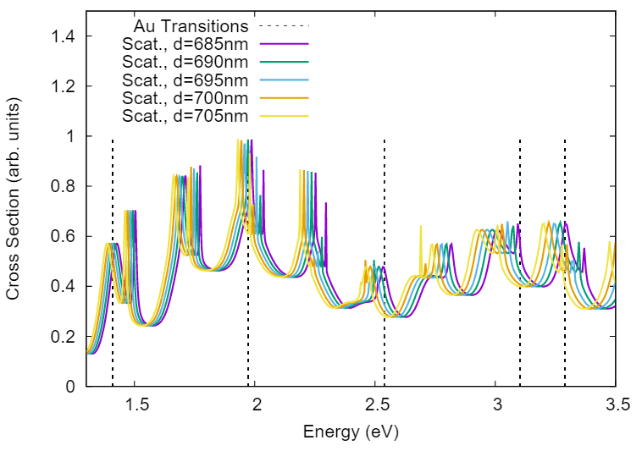
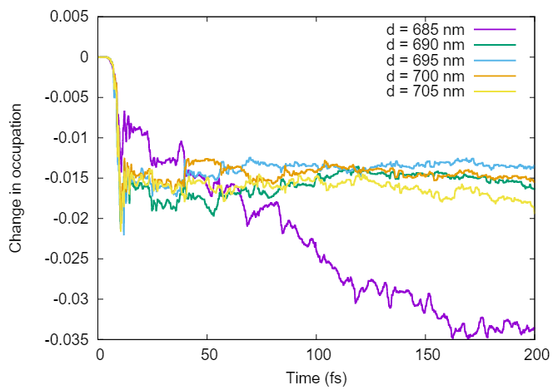
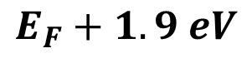
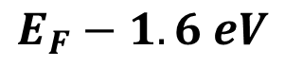
a)
b)
$$E_{F}+1.9 eV$$
Change in Occupation
c)
$$E_{F}−1.6 eV$$
Time (fs)

Slide 9
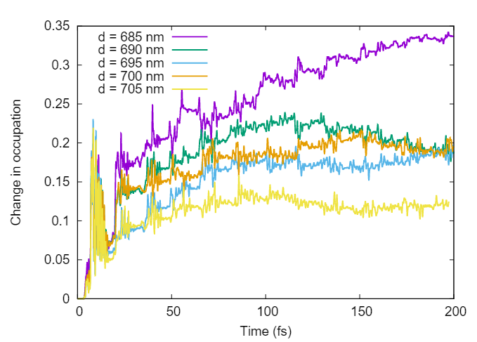
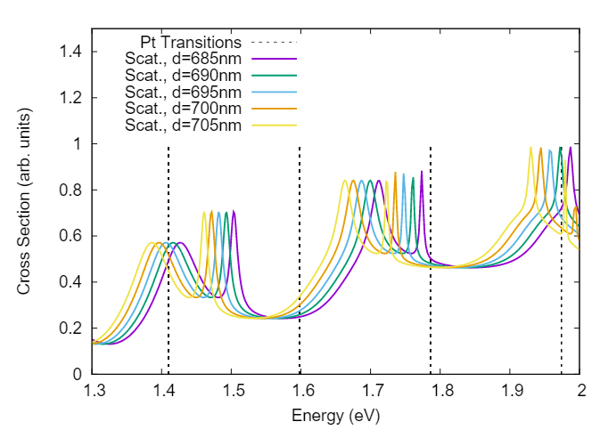
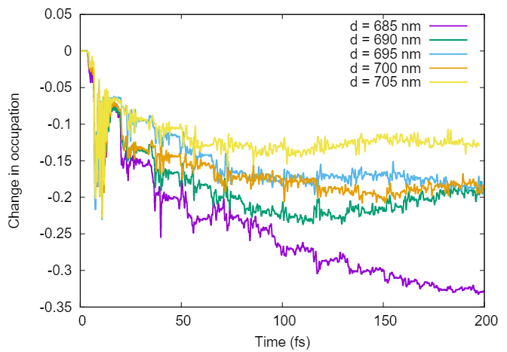
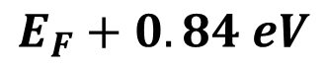
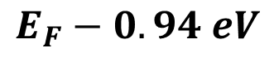
a)
b)
$$E_{F}+0.84 eV$$
Change in Occupation
c)
$$E_{F}−0.94 eV$$
Time (fs)

Slide 10
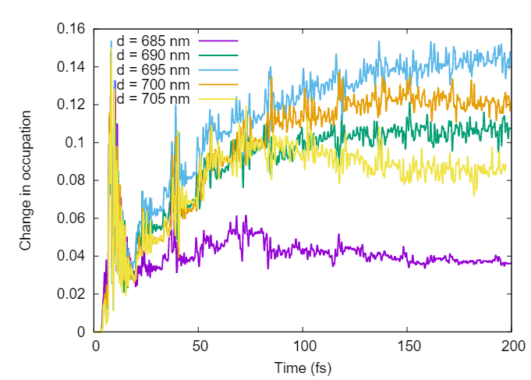
0.84 eV above Fermi
1.97 eV transition -> holes -0.94 eV below Fermi (orbital 1)
Hot elecrons 0.84 and 1.03 eV above Fermi (orbital 14 and 15)
-0.94 eV below
1.03 eV above Fermi

